Slide 1
Nsefu Wildlife Conservation Foundation
Extinction…not on our watch

Slide 2
Here are the sobering facts about extinction!
96 Elephants are killed every single day, 365 days a year.
We have less than 8 years to prevent their extinction in the wild.
They are killed for their ivory driven by black market demand in Asia where ivory is considered a status symbol.
Rhinos number less than 25,000 and 4 species have been deemed extinct as of the last 15 years.
Lions number less than 25,000 and only exist in 6 countries anymore.
Giraffes are experiencing a silent extinction due to trophy hunting and bush meat. Currently their numbers stand at less than 40,000.

Slide 3
This is what poaching looks like.

Slide 4
Nsefu History Overview
Founded in Spring of 2015.
Ranger Program developed Winter of 2015.
Chabwela School founded Spring 2018.
Beekeeping Program founded Summer 2018.
Sewing Program founded Summer 2018.

Slide 5
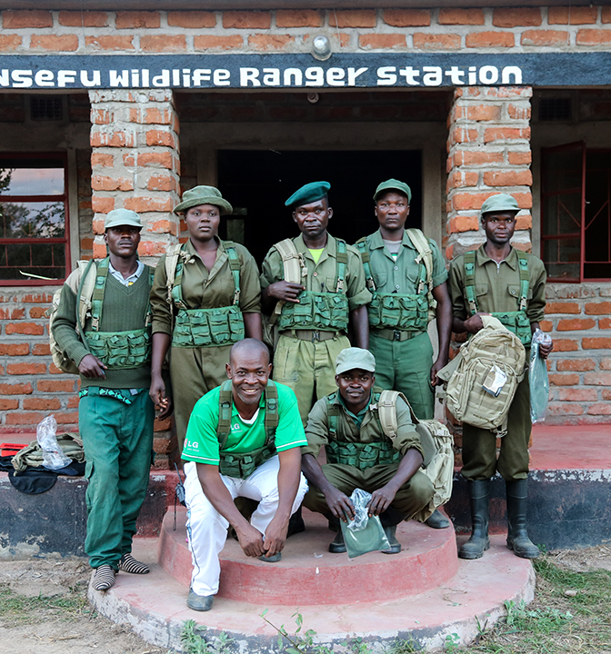
Ranger Program
In 2018, our Nsefu Wildlife Rangers have made over 50 poacher arrests.
Nsefu arrests have resulted in a high conviction rate.
Close to 1000 snares have been collected.
Multiple guns, rifles and other poaching contraband have been confiscated.

Slide 6
This is what we are protecting from extinction!

Slide 8
Nsefu Wildlife’s blueprint for impactful conservation.
Nsefu Wildlife is using a multi-pronged approach to tackling the crisis of poaching.
Zambia is one of the poorest countries in the world and poverty is a driver behind wildlife crime.
We believe engaging the community in our long-term solutions is the only way to have a genuine impact.
By introducing economic opportunities into the community helps create deep bonds between Nsefu Wildlife and the local citizens.
In fact, Nsefu Wildlife is the first of its kind to create a board of directors with a majority of Zambians as members.

Slide 9
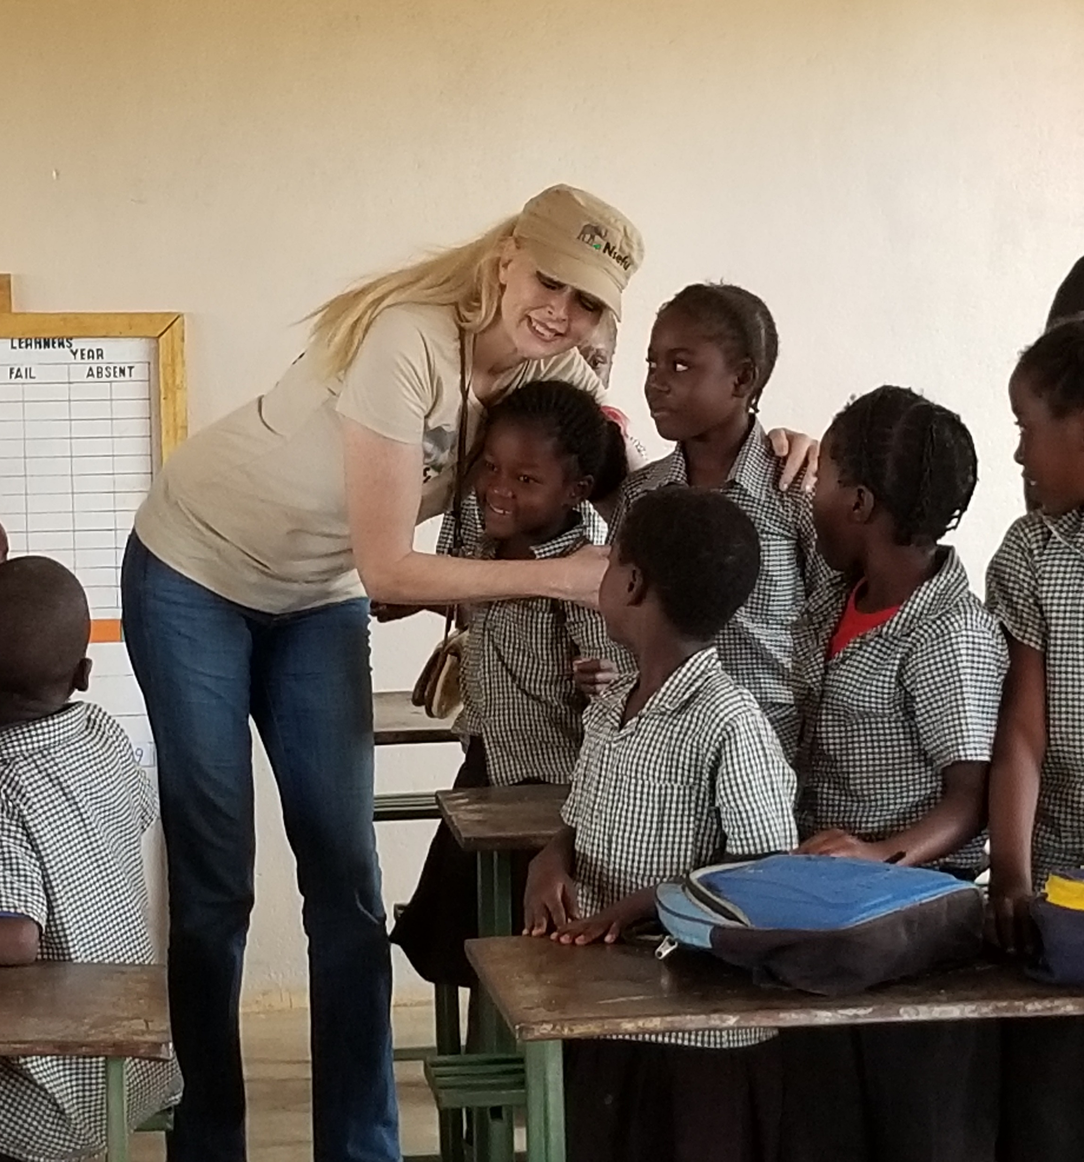
Chabwela School – Guardians of the Future!
Chabwela School was a couple of mud huts where teachers and children would meet daily.
An education in Africa is deemed more valuable than treasure.
This school was built by Nsefu Wildlife as our long term commitment to the community and as part wildlife conservation program.

Slide 10
Chabwela is a smash hit!

Slide 11
To Save the Future, you must educate Today!
Chabwela was originally built for the 60 local children. Today, Chabwela serves approximately 300 children.
Nsefu Wildlife is attempting to raise funds to build two more classrooms and toilets to separate age groups and grades.
Each classroom costs approximately $12,500 and because the community is so committed to Chabwela, many parents donated their time to help build the school.
Nsefu Wildlife believes in order to save the future of Zambia, the children must be educated about the value of their precious wildlife and natural resources.

Slide 12
Build it and they will come!

Slide 13
Chabwela School is creating future leaders!
Part of Nsefu Wildlife’s multi-pronged approach is engaging the children with their wildlife. We’re trying to teach children that the animals are not just beasts of burden or pests as they are taught growing up.
We made it mandatory that wildlife education and appreciation be taught in the very first grades. We even started a program where every month, the students who have achieved excellent grades or excellent citizenship are treated to game drives in the park with a full lunch included. This has been an outstanding success.
Nsefu Wildlife hopes to introduce this program into all local schools.

Slide 14
Beekeeping
The introduction of the Nsefu Wildlife Beekeeping Program has been very exciting in the community.
Beekeeping and Beehives serve two important purposes.
A.) Creating income opportunities with the selling of honey production.
B.) Creating natural human/animal conflict deterrents, aka Bee Fencing.
As we speak, countless local citizens are learning how to manage beehives and we are in the process of ramping up hives for production.

Slide 15
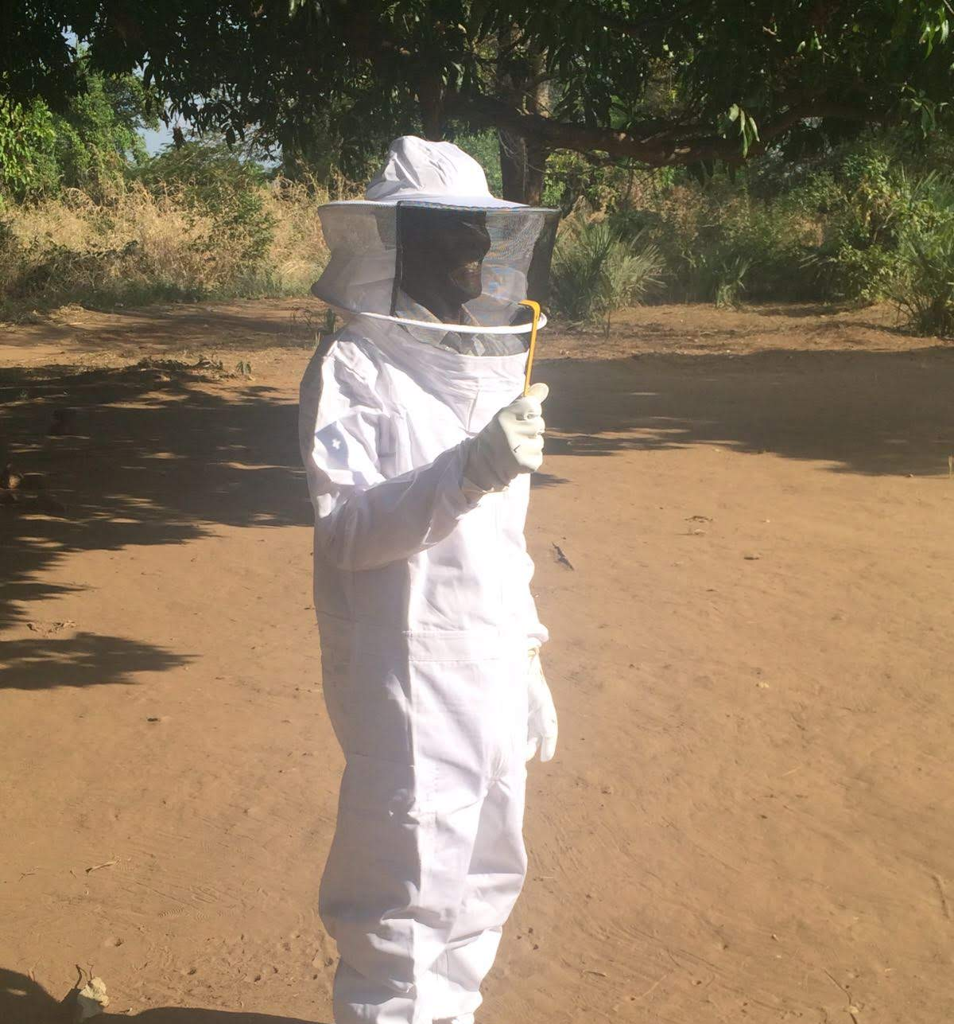
It’s a bird, it’s a plane…it’s a Bee Keeper
One of our first Bee Keepers with the Nsefu Wildlife Beekeeping Program.

Slide 16
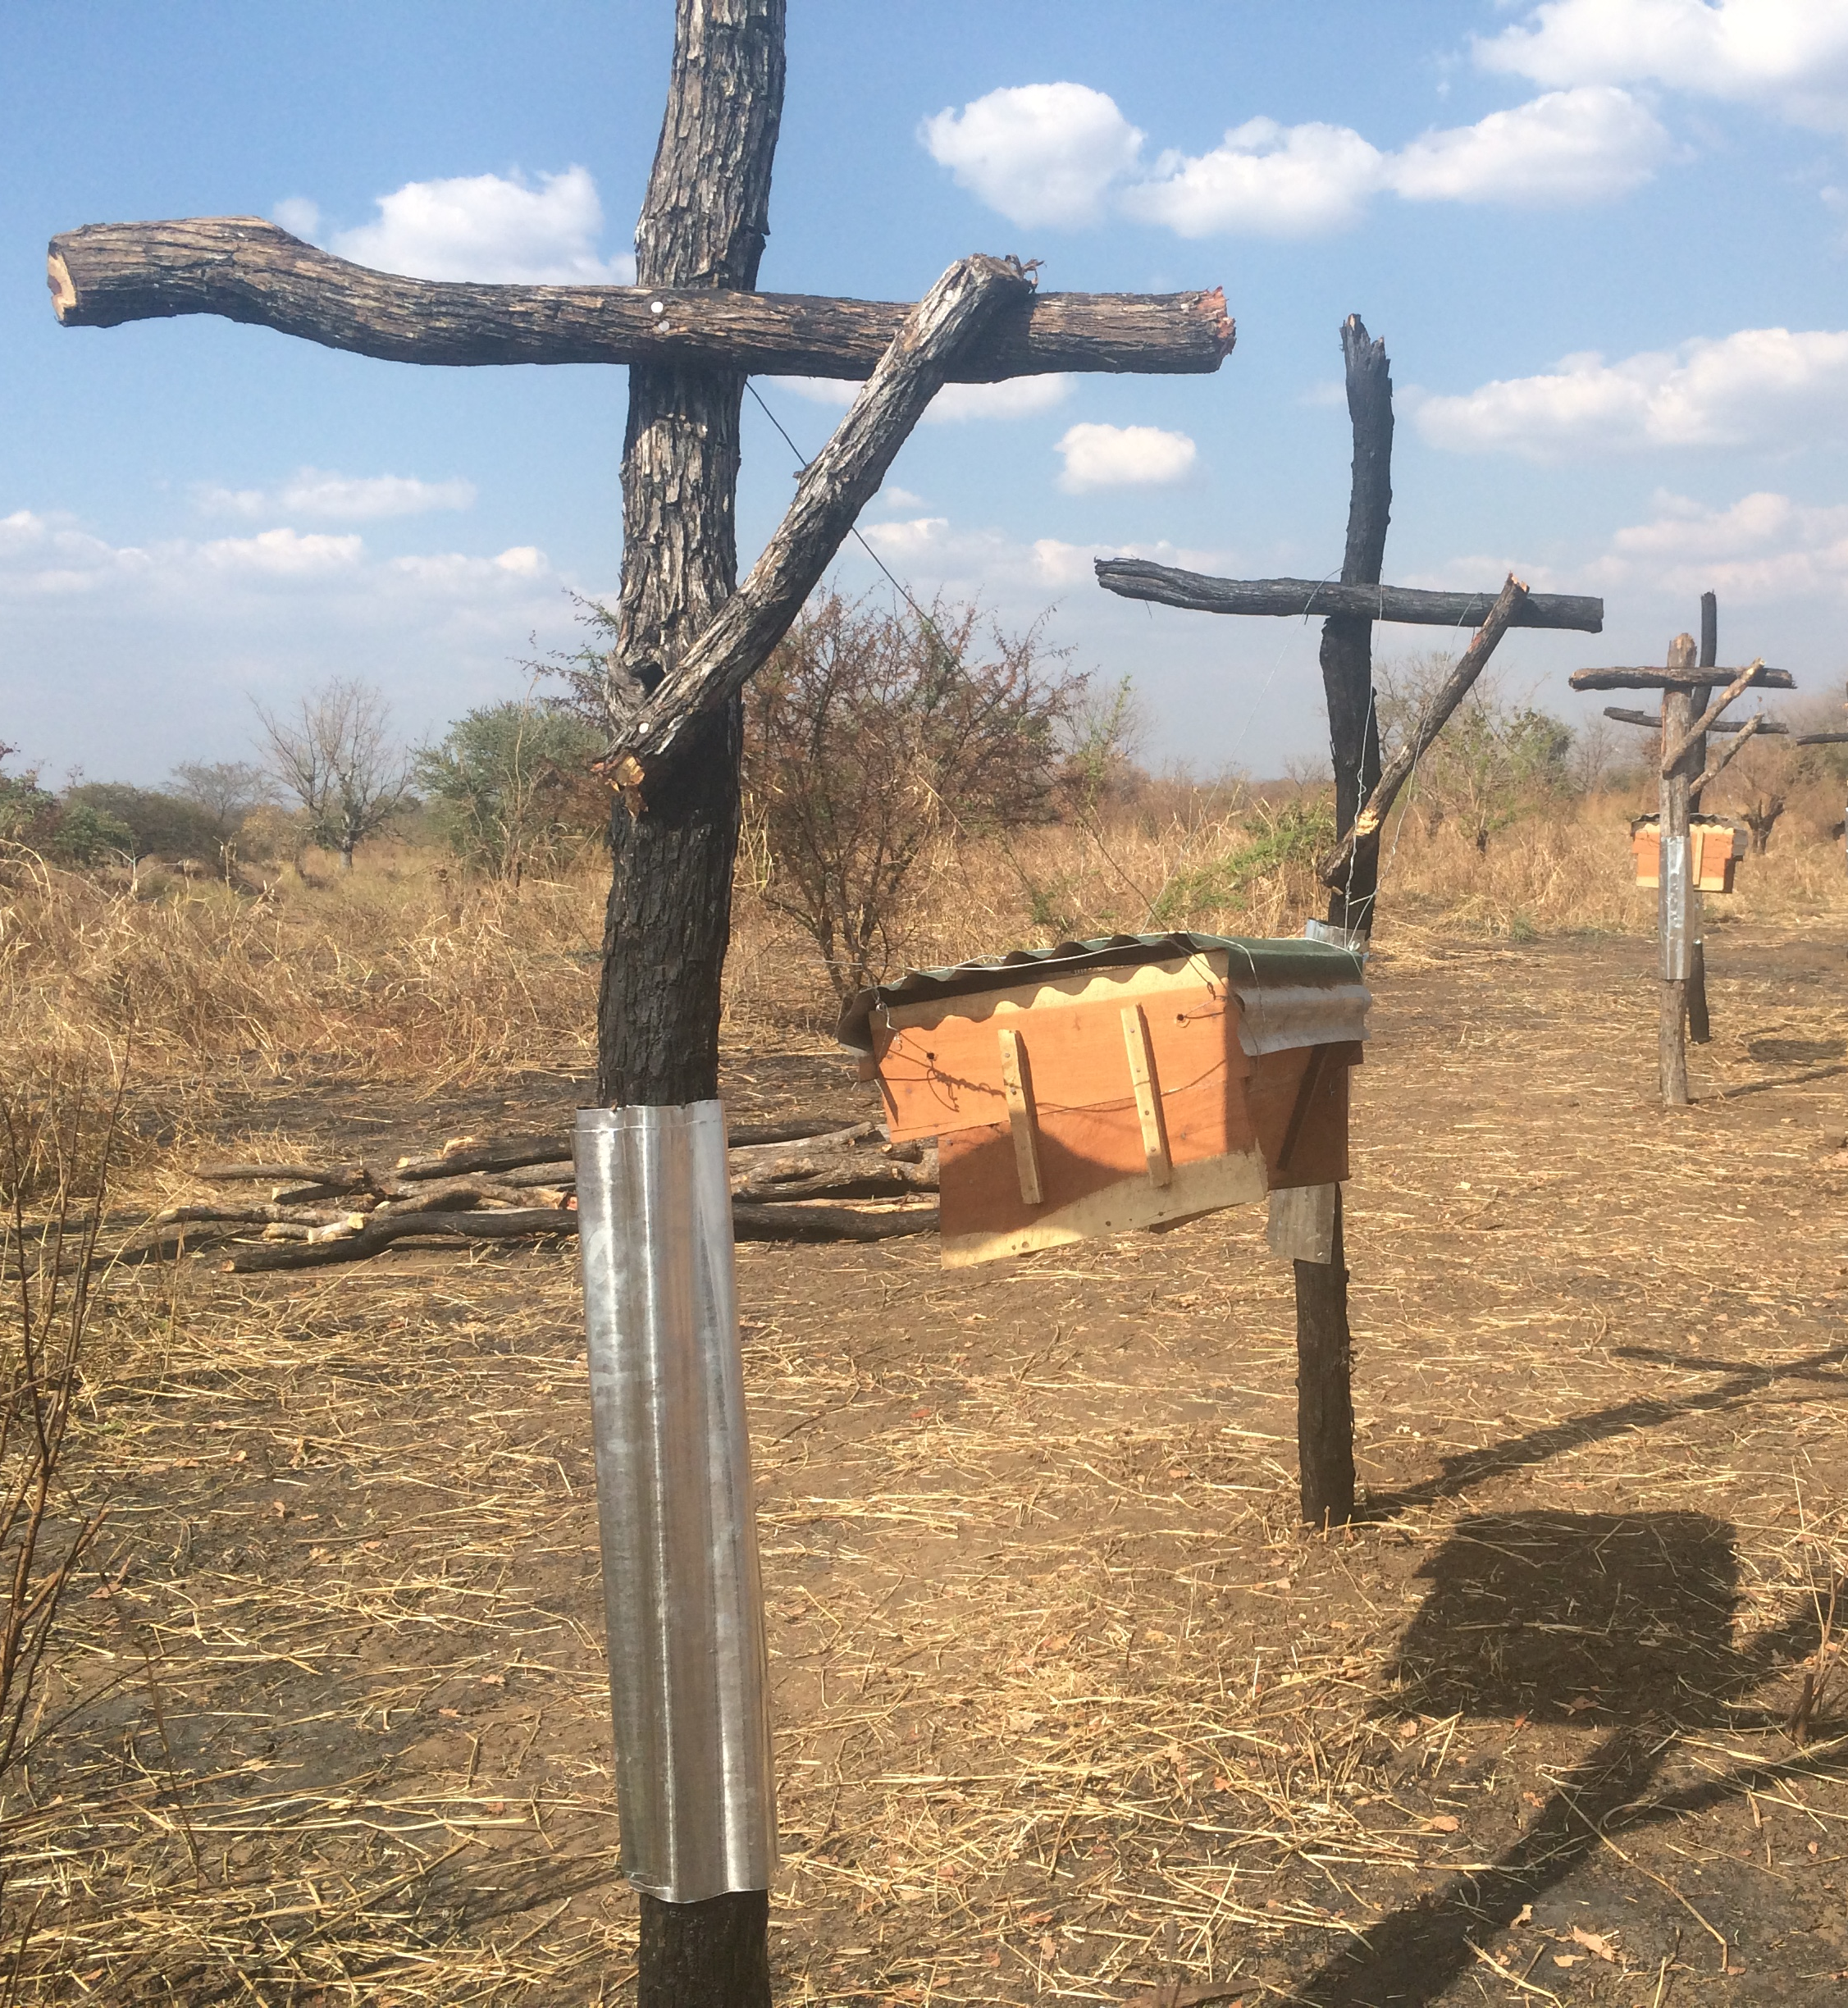
Bee Fencing saves lives…human and animal.
A brilliant way to reduce human and animal conflict is using nature. Most wildlife are deathly afraid of African Bees.
Our concept of creating Bee Fencing has been extremely popular with farmers and locals with gardens.
Pictured is a Bee Fence that was built to keep Elephants out of a vulnerable area for farmers. Elephants were being killed because crops were being decimated.
We are in the process of building 1.5 kilometers of fence to divert wildlife from crops.

Slide 17
Sewing brings independence, income & equality.
We are proud to report the Nsefu Wildlife sewing program is up and running.
We are teaching local women and others interested in learning valuable sewing skills in order to provide income for families.
We have the Nsefu Sewing Center and currently have 6 treadle machines and an instructor.
A call was put out to the community for 6 open training positions and 131 women showed up. We hope to expand our program dramatically to provide items like school uniforms and camp uniforms for the region.

Slide 18
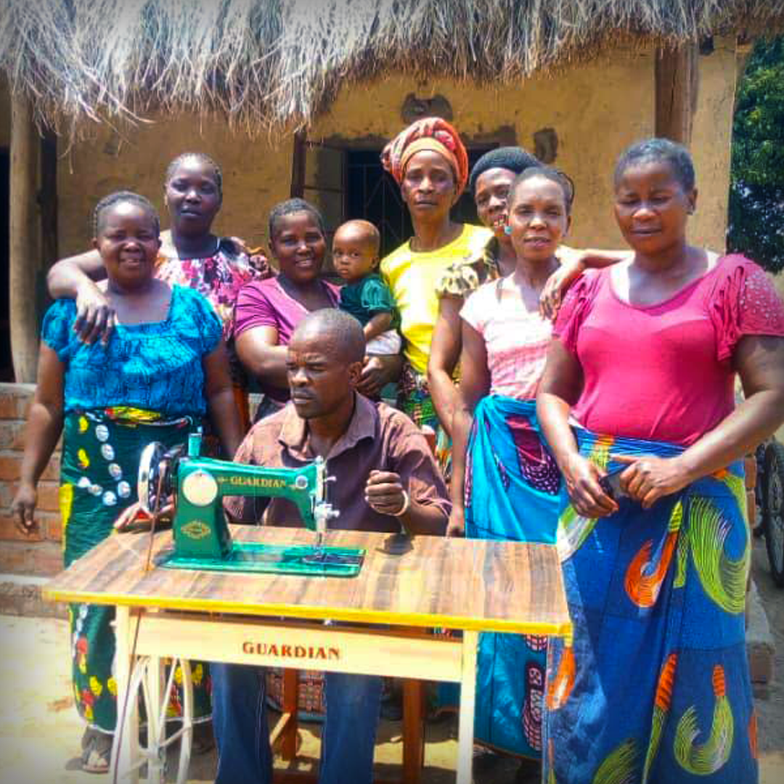
Our first recruits!
We have a paid instructor teaching our women valuable sewing skills.
Our vision is to be the resource for school uniforms and local business uniforms, i.e. safari camps.
For many of these women, this is the first time they will have ever earned an income once their training is complete… and they are so excited!

Slide 19
In conclusion…
For Nsefu Wildlife, not even being four years old yet, we have achieved much in the Nsefu Sector of Zambia.
What was a discussion between the two co-founders in the winter of 2014, to what Nsefu Wildlife Conservation Foundation is today, is a result of a fiercely dedicated group of board members and supporters who want to change the world. We are saving countless wildlife, we are employing many Zambians, and we are changing the future of children.
To stop extinction in its tracks, we cannot do this alone. We need YOUR HELP! To learn more on how YOU can change the world, visit Nsefu.org.

Slide 20
The animals thank you.

